Slide 1

Department of CSE
DESIGN AND ANALYSIS OF ALGORITHMS
24CS2203
Topic:
Divide and Conquer
Convex Hull

Slide 2
Convex vs Concave
A polygon P is convex if, for every pair of points x and y in P, the line xy is also in P; otherwise, it is called concave.
x
P
y
x
P
y
concave
convex

Slide 3
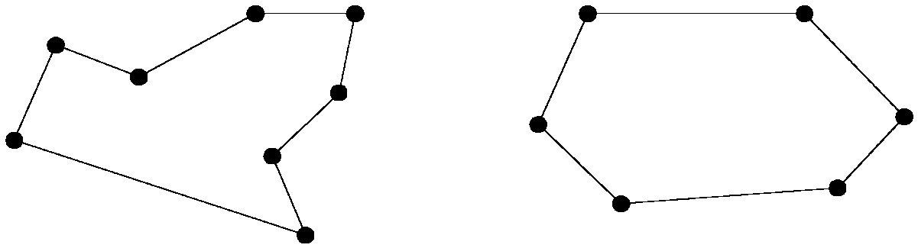
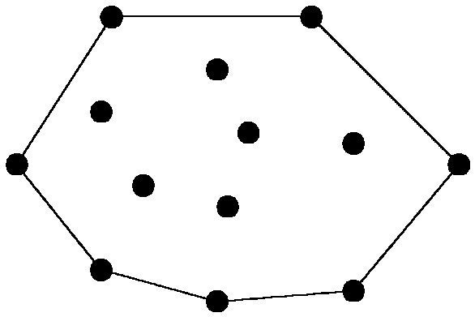
Convex Hull Problem
concave polygon:
convex polygon:
The Convex Hull problem is about finding the smallest convex polygon that can enclose a given set of points in a 2D plane.
One efficient approach to solve this problem is the Divide and Conquer technique, which breaks the problem into smaller subproblems, solves them independently, and then merges the results.

Slide 4
Divide & Conquer
Steps:
Sort the Points:
Sort the given points based on their x-coordinates (if x-coordinates are the same, use y-coordinates).
Sorting takes O(nlog⁡n)
Divide the Points:
Split the sorted points into two halves (left and right).
Recursive Hull Computation:
Recursively find the convex hulls for both halves.
Merge the Hulls:
Find the upper and lower tangents to combine the two convex hulls.
Remove the points that are not part of the final convex hull.
Notes:
Positive cross product is right turn, negative is left turn

Slide 5
Divide & Conquer
Merge Step (Key Challenge)
Merging two convex hulls involves:
Finding the Upper Tangent:
Start from the rightmost point of the left hull and the leftmost point of the right hull.
Move counterclockwise on the left hull and clockwise on the right hull until the tangent is found.
Finding the Lower Tangent:
Similar to the upper tangent but in the opposite directions.
Combine the hulls by removing the interior points.
Notes:
Positive cross product is right turn, negative is left turn

Slide 6
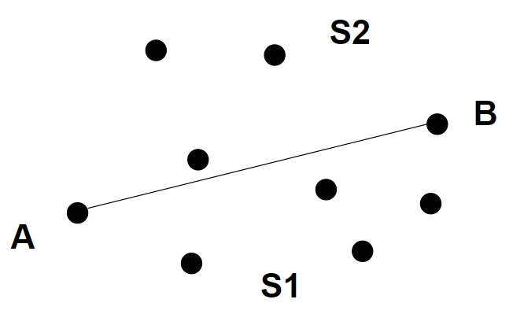

Slide 7
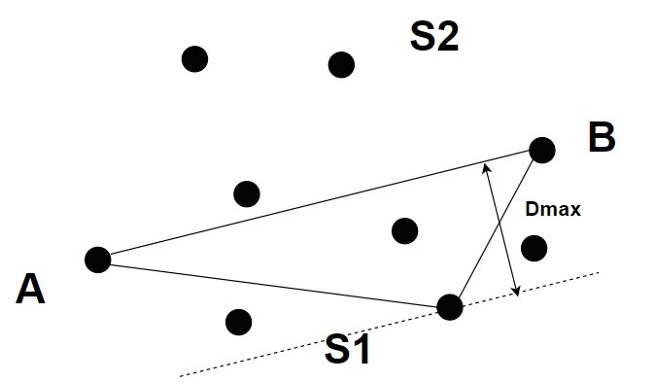

Slide 8
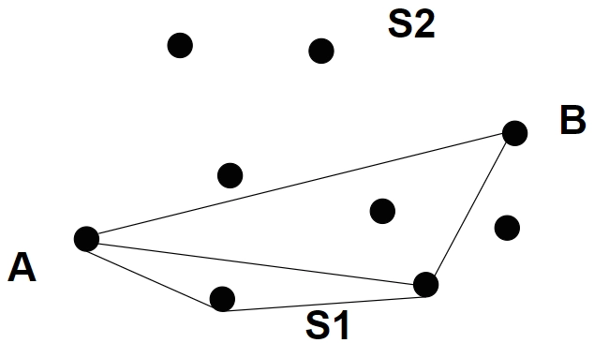

Slide 9
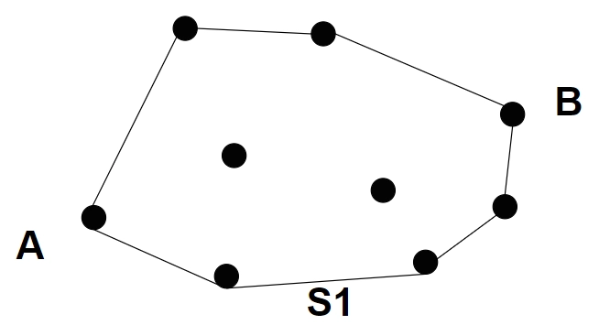

Slide 10

Time complexity
The best-case, worst-case, and average-case time complexity of this approach is O(n*logn) because the merging of the two convex hulls takes $O(n)$ time, and we are diving the set of points into left and right halves, so it takes $O(logn)$time, hence in total, the algorithm will take $O(n∗logn)$time.
Notes:
Positive cross product is right turn, negative is left turn

Slide 11
Graham’s Scan
Graham scan is a method of finding the convex hull of a finite set of points
Steps:
Start at the point guaranteed to be on the hull. (the point with the minimum y value i.e is the leftmost and bottommost point in Y coordinate)
Sort the points by angle relative to the bottommost and horizontal points.
Iterate in sorted order, placing each point on a stack, but only if it makes an anti-clockwise turn relative to the previous 2 points.
Pop previous points off of the stack if making a clockwise turn.
Notes:
Positive cross product is right turn, negative is left turn

Slide 12
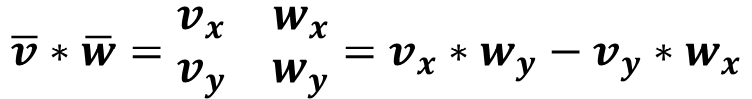
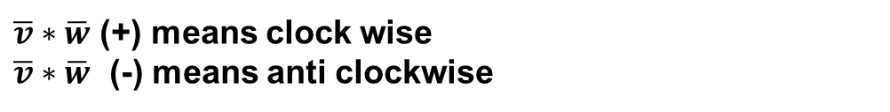
$$\overline{v}∗\overline{w}=\begin{matrix}v_{x} & w_{x} \\ v_{y} & w_{y}\end{matrix}=v_{x}∗w_{y}−v_{y}∗w_{x}$$
$\overline{v}∗\overline{w}$ (+) means clock wise
$\overline{v}∗\overline{w}$ (-) means anti clockwise
$\overline{w}$
$$\overline{v}$$

Slide 13
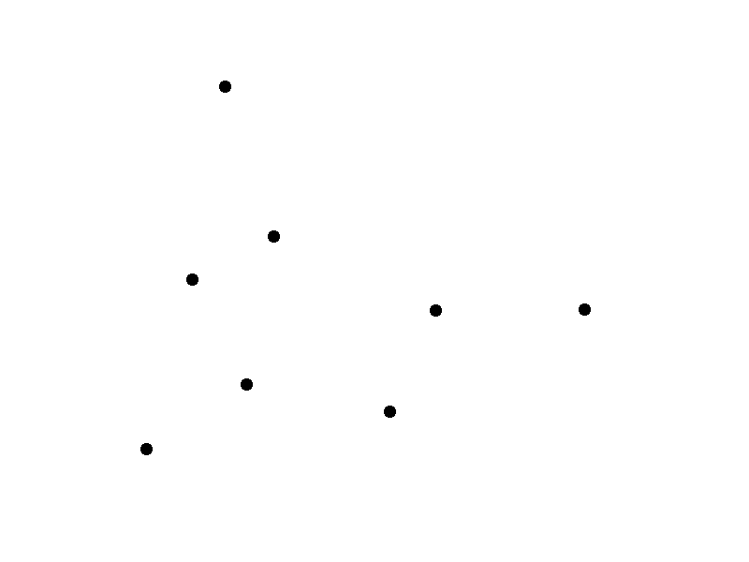
Graham’s Scan

Slide 14
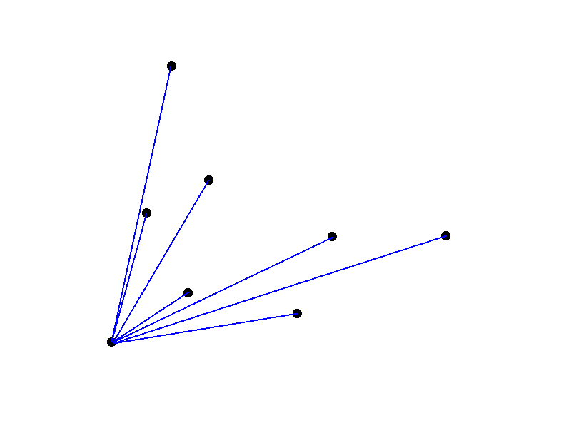
Graham’s Scan

Slide 15
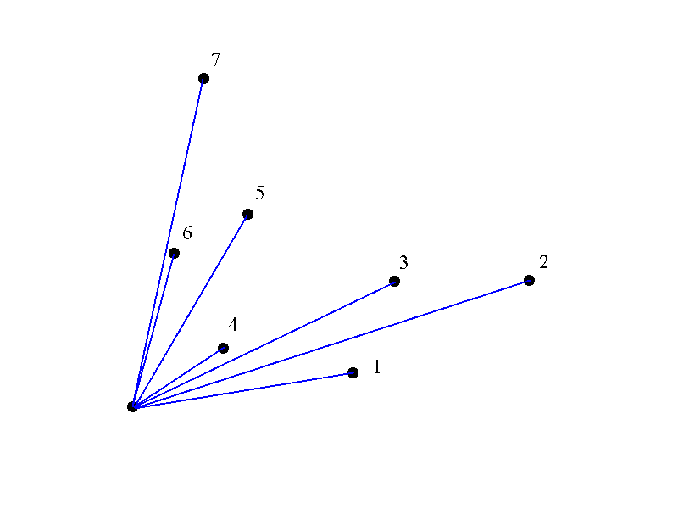
Graham’s Scan
1

Slide 16
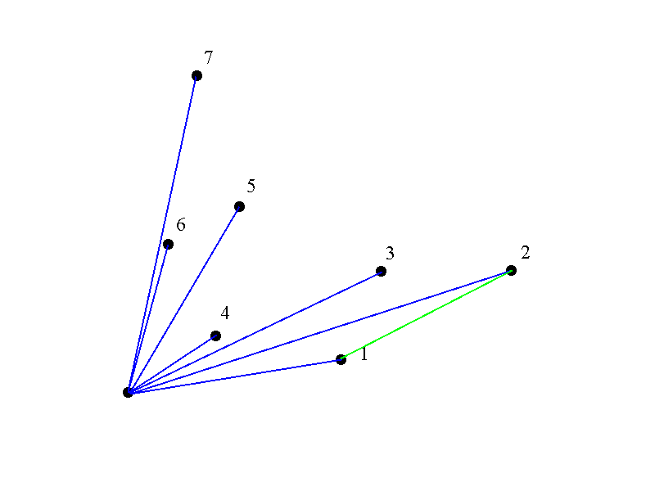
Graham’s Scan
2
1

Slide 17
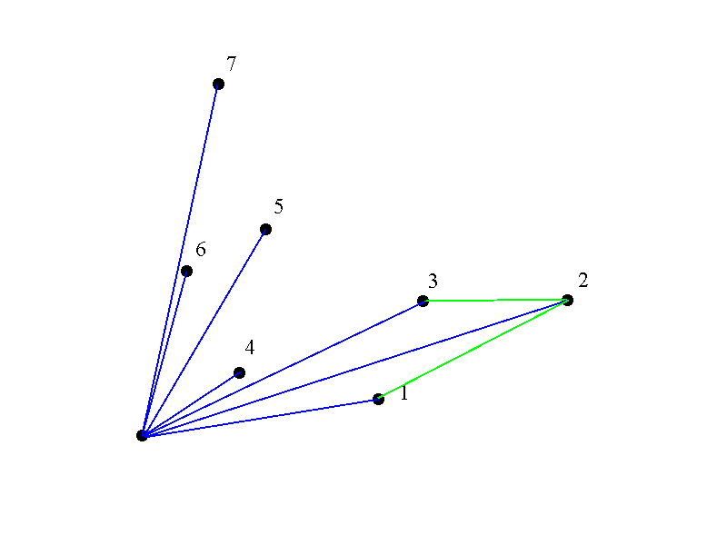
Graham’s Scan
3
2
1

Slide 18
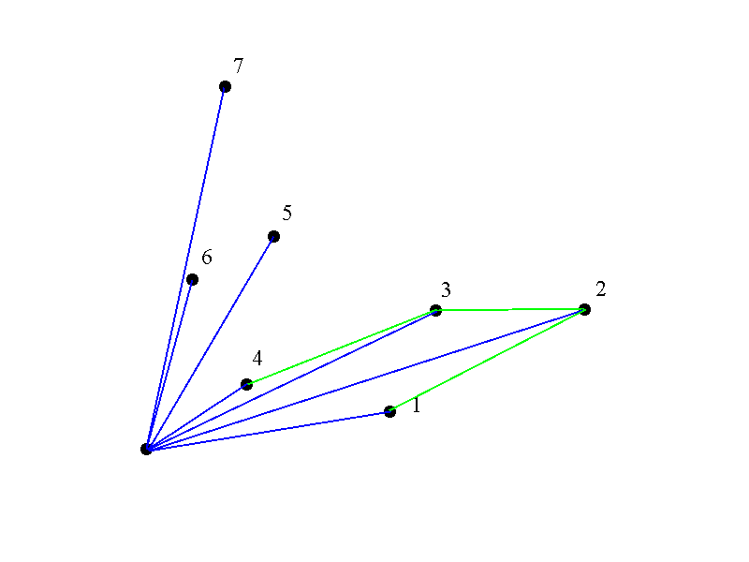
Graham’s Scan
4
3
2
1

Slide 19
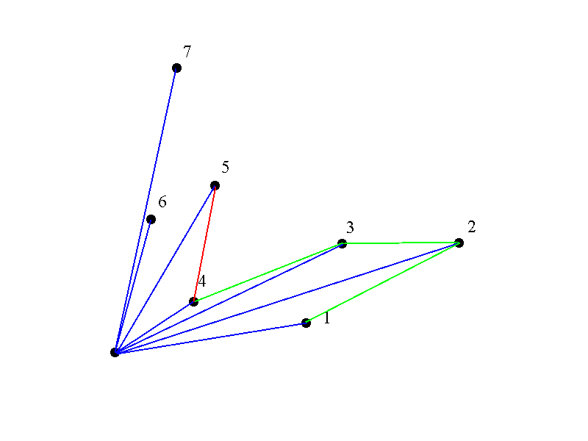
Graham’s Scan
4
3
2
1

Slide 20
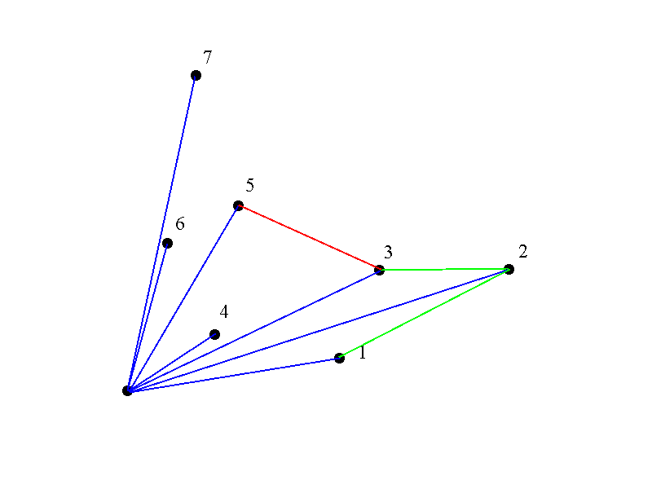
Graham’s Scan
3
2
1

Slide 21
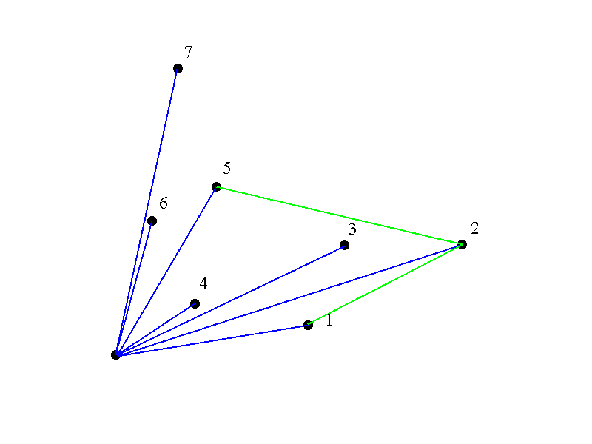
Graham’s Scan
5
2
1

Slide 22
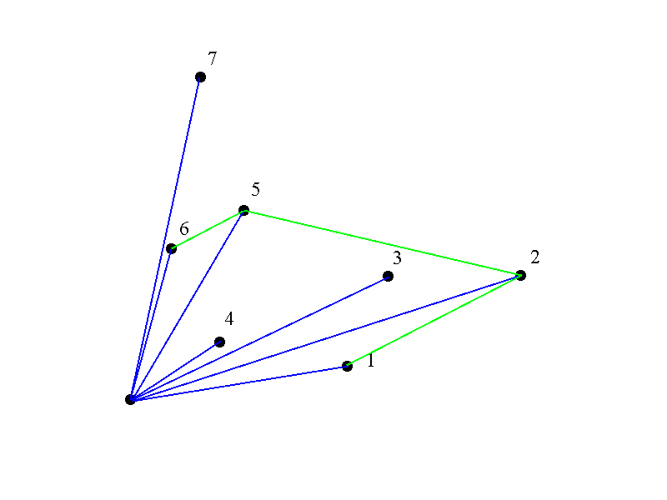
Graham’s Scan
6
5
2
1

Slide 23
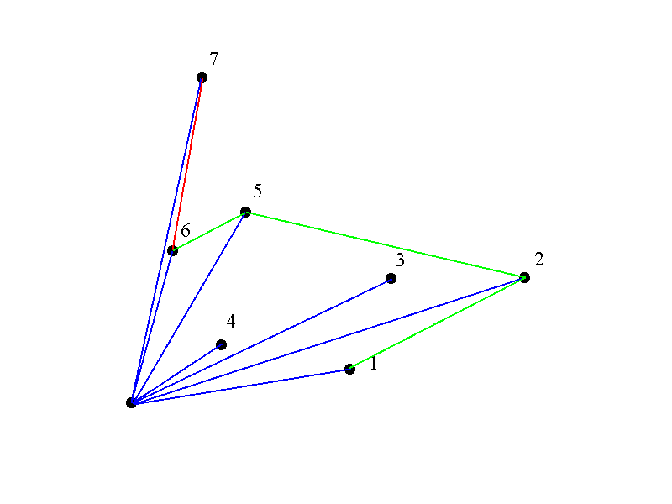
Graham’s Scan
5
2
1

Slide 24

Graham’s Scan
2
1

Slide 25
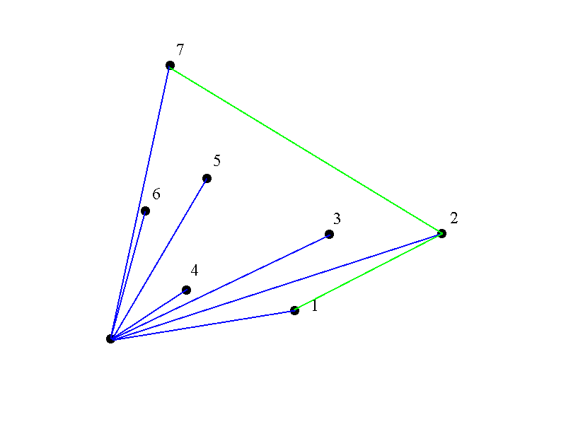
Graham’s Scan
7
2
1

Slide 26
Graham’s Runtime
Graham’s scan is O(n log n) where n is the number of points in the shape.
Disadvantages:
This makes it an efficient algorithm for small to medium-sized shapes. However, for large shapes, the algorithm can take a significant amount of time to compute the convex hull.

Slide 27
Graham’s Algorithm
Graham-Scan(Q)
Let p0 be the point in Q with the minimum y-coordinate, or the leftmost such point in case of tie.
Let <p1, p2,…, pm> be the remaining points in Q, sorted by polar angle in counterclockwise order around p0(if more than one point has the same angle, remove all but the one that is farthest from p0).
Push(p0, S)
Push(p1, S)
Push(p2, S)
for i 3 to m:
do while the angle formed by points NEXT-TO-TOP(S), TOP(S), and pi makes a nonleft turn.
do POP(S)
PUSH(pi, S)
Return S

Slide 28
Example

Slide 29
Ex: Draw the convex hull for the following points
(1,1),(2,3),(3,5),(5,3),(3,2),(2,2),(6,1),(7,4)

